Slide 1

Advanced Programming
(C Programming language)
Chapter4– Beginnig Decision Making and Looping

Slide 2
Flow Control
Relational expressions
if, if/else statement
Looping statements
  while
  do while
  for

Slide 3
Decision Making
Suppose you want to write a program that converts a mark into grade
Key point is to decide which grade apply to the mark examined
Decision making – important operation in programming
Mark | Grade
0–49 | F
50–59 | D
60–69 | C
70–79 | B
80–100 | A

Slide 4
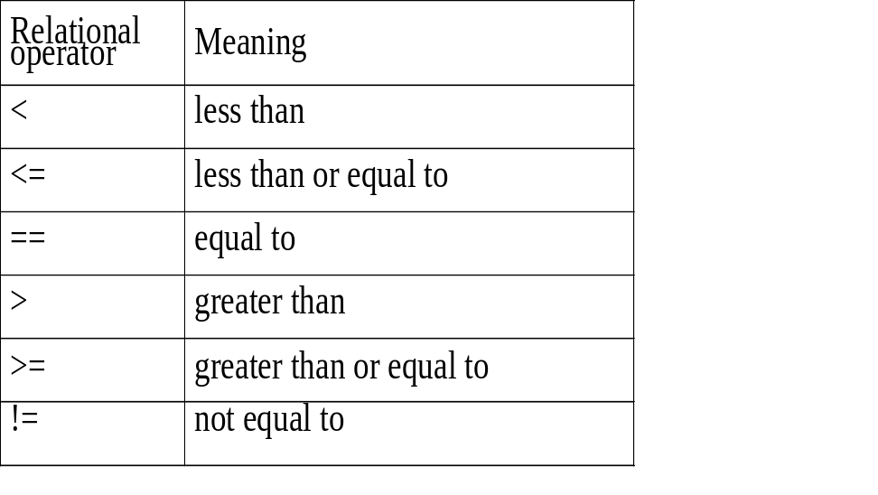
If Control Structure and
Relational Expressions
If statement often is used for decision making
A relational expression that compares two values is contained in if statement
General format
operand relational_operator operand
Produces a result of either true or false
Operand can be variables or any arithmetic expression

Slide 5
Relational Expression
Compares the values of two arithmetic expressions, produces a result of either True or False
General syntax
left_operand relational_operator right_operand
Operand can be variables, or any arithmetic expression.
E.g.
i < 5
I + j > 3 * k

Slide 6
Table of Relational Operator
Relational operator Meaning
< less than
<= less than or equal to
== equal to
> greater than
>= greater than or equal to
!= not equal to

Slide 7
If Statement
General form
if (expression) statement;
If logical expression is True, statement behind if expression is executed
If logical expression is False, statement behind if expression is not executed

Slide 8
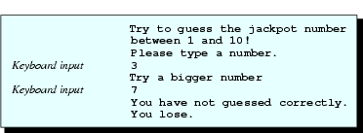
If Statement
int i, guess, jackpot=8;
printf("Try to guess the jackpot number \nbetween 1 and 10!\n");
printf("Please type a number.\n");
scanf("%d",&guess);
if (guess<jackpot)
printf("Try a bigger number\n");
Introduction to Programming in C

Slide 9

Block If
A block if statement
if (condition) { statements... }
or
  Statements in the “true” block (between two braces) are executed if logical expression is true
  Otherwise the entire block is ignored
Indentation
  For readability of your programs
  Code block should be indented one tab (at least three spaces) in from the keyword if
  Not a must, but common practice in programming

Slide 10
Equality Operator
Difference between = and ==
  = is assignment but == is a relational operator
  must not be confused as will cause serious errors
Not recommended to use == to compare values of double or float!
Typical C compiler carries many significant digits for the real variable types
If two fractional values are compared with == and they differ in only the last significant digit, then the result of a comparison with == is false

Slide 11
if (guess>jackpot)
printf("Try a smaller number\n");
if (guess==jackpot)
printf("Verify your guess by typing it one more time\n");
scanf ("%d", &guess);
if (guess==jackpot)
{
printf("You hit the \n");
printf("JACKPOT!\n");
}
if (guess!=jackpot)
printf("You have not guessed correctly.\nYou lose.\n");

Slide 12
Equality Operator
In most cases, we are interested only if the numbers are nearly or very nearly equal, e.g.,
x = 0.1;
x * 9 == 0.9 will return False
So how do we compare two real values?
  use the fabs function and <
  to compare the double values of a and b
  if ( fabs (a-b) < 1.0e-10)
  1.0e-10 assume using double,
  you will need to decide how small that number should be

Slide 13
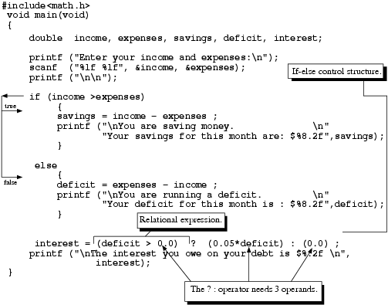
Introduction to Programming in C

Slide 14
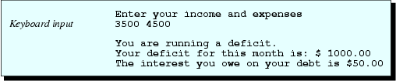
If-else Control
Sample run
If-else syntax
  if (expression)
  {
  executable statement 1a;
  ...
  }
  else
  {
  executable statement 2a;
  ...
  }
If the expression is true, statements in the true(1) block are executed
If the expression is false, control is transferred to the false block (2)

Slide 15
double income, expenses, savings, deficit, interest;
printf ("Enter your income and expenses:\n");
scanf ("%lf %lf", &income, &expenses);
printf ("\n\n");
if (income>expenses)
{
savings = income - expenses;
printf ("\nYou are saving money.\n“
"Your savings for this month are: $%8.2f", savings);
}
else
{
deficit = expenses - income;
printf ("\nYou are running a deficit.\n"
"Your deficit for this month is: $%8.2f", deficit);
}
Introduction to Programming in C

Slide 16
Conditional Operator
? : conditional operator
Requires three operands
Format
expr1 ? expr2 : expr3
If expression1 is true, expression2 is evaluated
If expression1 is false, expression3 is evaluated
Value of entire expression becomes value of expression evaluated
E.g.
x = (y<z) ? y : z;
assigns x the value of the smaller of y and z

Slide 17
Conditional Operator
interest = (deficit > 0.0) ? (0.05*deficit) : (0.0);
printf ("\nThe interest you owe on your debt is $%.2f\n", interest);

Slide 18
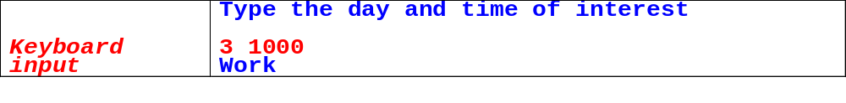
Nested If-Else
An if-else control structure can be contained within another if-else
Suppose you have a work schedule as follow:
Weekdays
  (Days 1–5)
  0:00–9:00 Sleep
  9:01–19:00 Work
  19:01–23:59 Relax
  Weekends
  (Days 6–7)
  0:00–11:00 Sleep
  11:01–23:59 Have fun
We want to write a program to report the activity for any input day and time, sample run as below:

Slide 19
#include <stdio.h>
void main (void)
{
int day;
int hour, min;
printf ("Type the day and time of interest\n\n");
scanf ("%d%d", &day, &time);
if (day <= 5)
{
if (time <= 900)
printf ("Sleep\n\n");
else
{
if (time <= 1900)
printf ("Work\n\n");
else
printf ("Relax\n\n");
}
}
else
{
if (time <= 1100)
printf ("Sleep\n\n");
else
printf ("Have fun\n\n");
}
}

Slide 20
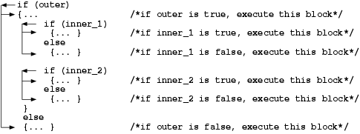
Nested If-Else
Use indentation – indent each pair of if-else so that inner else is paired with inner if and outer else is paired with outer if
Total number of “ifs” can be greater than or equal to total number of “elses”.
An else clause is associated with the closest previous if statement that has no other else statement

Slide 21

-1 （x<0）
y= 0 （x=0)
1 （x>0）
Wrong or right？
1：
main()
{
int x,y;
scanf("%d",&x)；
if(x<0)
y=-1；
else if(x==0)
y=0；
else
y=1；
printf("x=%d,y=%d\n",x,y)；
}
2：
main()
{
int x,y；
scanf("%d",&x)；
if(x>=0)
if(x>0)
y=1；
else
y=0；
else
y=-1；
printf("x=%d,y=%d\n",x,y)；
}

Slide 22
4：
main()
{
int x,y；
scanf("%d",&x)；
y=0；
if(x>=0)
if(x>0)
y=1；
else
y=-1；
printf("x=%d,y=%d\n"，x，y)；
}
3：
main()
{
int x,y；
scanf("%d",&x)；
y=-1；
if(x!=0)
if(x>0)
y=1；
else
y=0；
printf("x=%d,y=%d\n",x,y)；
}

Slide 23

[Excercise] input any year of the year, write a program to determine if the year is a leap year or not?
①Can be divisible by 4, but can not be divisible by 100.
②Can be divisible by 400.

Slide 24
main()
{
int year, leap；
scanf("%d",&year)；
if(year%4==0)
{
if(year%100==0)
{
if(year%400==0)
leap=1；
else
leap=0；
}else
leap=0；
}else
leap=0；
if(leap)
printf("%d is",year)；
else
printf("%d is not ",year)；
printf("a leap year\n")；
}
Output：
①1989
1989 is not a leap year
②2000
2000 is a leap year

Slide 25
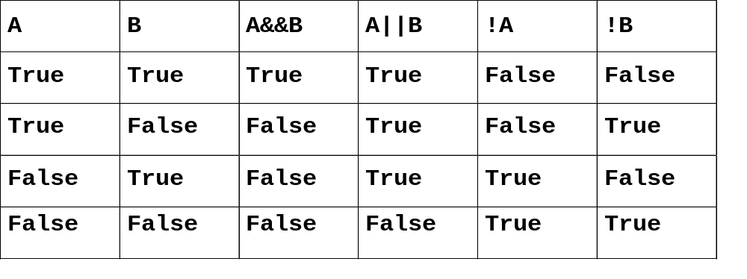
Logical Expressions
Used to connect two relational expressions, e.g.,
if (x == 0 && y == 0)
Logical operator
&& for “and.”
|| for "or"
! for "not“ - reverse logical value

Slide 26
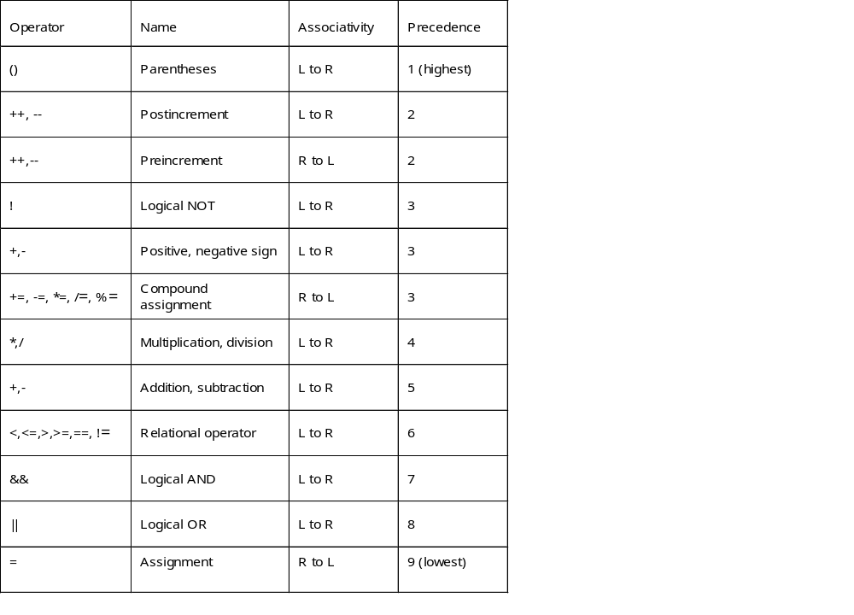
Logical Expressions
C gives relational expressions numerical values
  false gives a value of 0
  true gives a value of 1
Similar for variables
  If value of a variable is 0, then treated as being false
  If value of a variable is not 0, then treated as being true
Order of precedence for relational and logical operators on right

Slide 27
Example
  char c=‘B’
  int i=3,j=3,k=3
  double x=0.0,y=2.3
Expression
  i && j && k
  x || i && j-3
  i < j && x < y
  ‘A’ <= c && c <= ‘Z’
  c-1 == ‘A’ || c+1 == ‘Z’

Slide 28
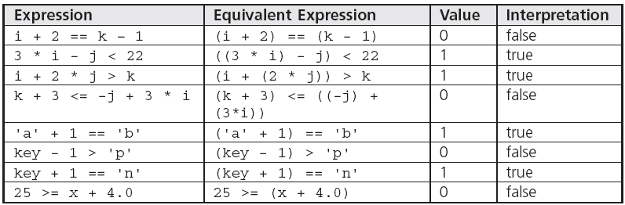
  char key = 'm';
  int i = 5, j = 7, k = 12;
  double x = 22.5;
  (6 * 3 == 36 / 2) && (13 < 3 * 3 + 4) || !(6 - 2 < 5) =
  (18 == 18) && (13 < 9 + 4) || !(4 < 5) =
  1 && (13 < 13) || !1 =
  1 && 0 && 0 =
  1 && 0 =
  0

Slide 29
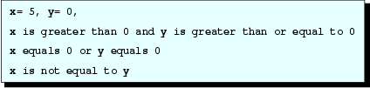
Logical Expressions
int x=5, y=0;
printf ("x=%2d, y=%2d\n\n", x, y);
if (x>0 && y>=0)
printf ("x is greater than 0 and“
"y is greater than or equal to 0\n\n");
if (x==0 || y==0)
printf ("x equals 0 or y equals 0\n\n");
if (! (x==y))
printf ("x is not equal to y\n");

Slide 30
Exercise: Leap year?

Slide 31

Switch
int option;
printf ("Please type 1, 2, or 3\n"
"1. Breakfast\n"
"2. Lunch\n"
"3. Dinner\n");
scanf ("%d",&option);
switch (option)
{
case 1: printf ("Good morning\n");
printf ("Order breakfast\n");
break;
case 2: printf ("Order lunch\n");
break;
case 3: printf ("Order dinner\n");
break;
default:
printf ("Order nothing\n");
}
Output

Slide 32
Switch
int option;
printf ("Please type 1, 2, or 3\n"
"1. Breakfast\n"
"2. Lunch\n"
"3. Dinner\n");
scanf ("%d", &option);
if (option==1)
{
printf ("Good morning\n");
printf ("Order breakfast\n");
}
else if (option==2)
printf ("Order lunch\n");
else if (option==3)
printf ("Order dinner\n");
else
printf ("Order nothing\n");
For comparison with switch statement

Slide 33
Switch
Case label: constant followed by colon
Looks for a match between the switch expression and the case label
Break statement send control to the point of the closing brace of switch
If no break statement is used, then the statements in the next case are executed
Default is a special label in the event that none of the case label constants agrees, control passes to the default labeled statement sequence
Switch control structures can be nested also

Slide 34
While Loop
Iterative control structures involves the repeated execution of one or more statements
  while (expression)
  {
  statements
  }
If result of expression is True, statements between the braces are executed and expression will be tested again
Leave the loop once expression is False

Slide 35

While Loop
int i;
i = 1;
while (i<=5)
{
printf ("Loop number %d in the while_loop\n", i);
i++;
}
Output

Slide 36
While Loop
int i=4, k=1, sum=0;
while (i)
{
printf ("old_i=%2d, ", i);
sum += i--;
printf ("new_i=%2d, sum=%2d\n", i, sum);
}
printf ("\n");
sum = 0;
while (k)
{
printf ("old_k=%2d, ", k);
sum -= k++;
printf ("new_k=%2d, sum=%2d\n", k, sum);
}
Output
  old_i= 4, new_i= 3, sum= 4
  old_i= 3, new_i= 2, sum= 7
  old_i= 2, new_i= 1, sum= 9
  old_i= 1, new_i= 0, sum=10
  old_k= 1, new_k= 2, sum= -1
  old_k= 2, new_k= 3, sum= -3
  old_k= 3, new_k= 4, sum= -6
  old_k= 4, new_k= 5, sum= -10
  old_k= 5, new_k= 6, sum= -15
  …
Second while loop is an infinite loop because the value of k never became 0

Slide 37
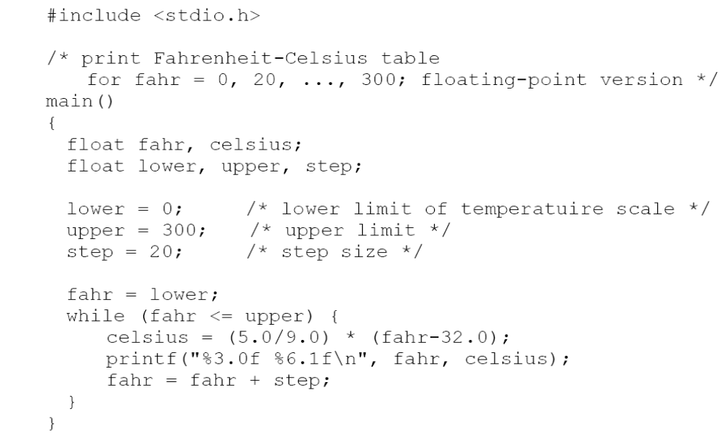

Slide 38
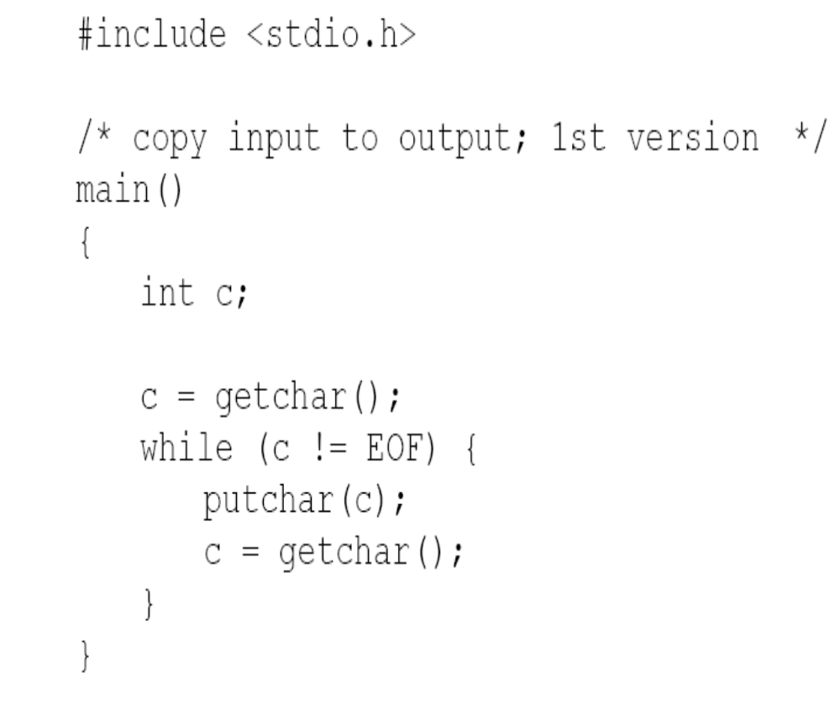
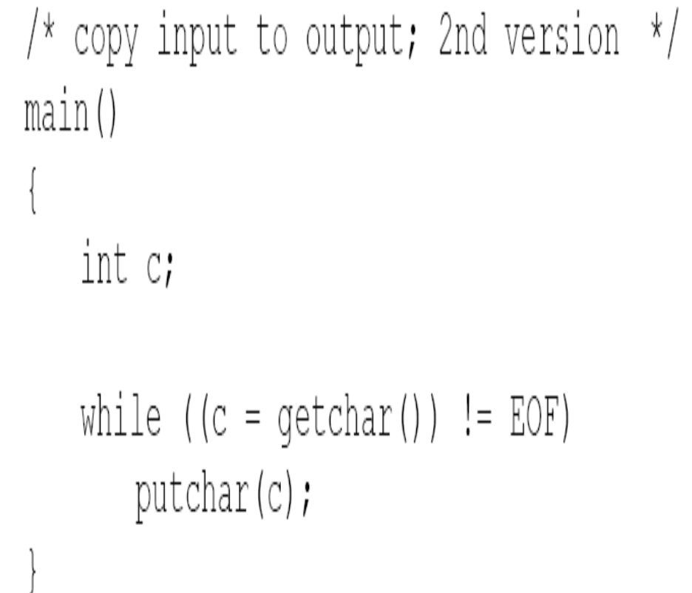

Slide 39

Do While Loop
int i=4, j=1;
do
{
printf ("old_i=%2d, ", i);
i--;
printf("new_i=%2d\n", i);
} while(i);
do
++j;
while (j>999);
printf ("j=%2d\n", j);
Output

Slide 40
Do While Loop
General form
  do
  {
  statement1;
  statement2;
  . . .
  }
  while (expression);
Statements between the braces are executed at least once

Slide 41
Example: factorial
int main()
{
int i = 0, n = 0, fact = 1;
printf("Enter a number\n");
scanf("%d", &n);
i=1; /* this is the counter */
while (i <= n)
{
fact *= i;
++i;
}
printf("the factorial is %d\n", fact);
return 0;
}
Initialize
Test
Increment

Slide 42
Example: the value of circumference ratio Pi can be calculated by the formula Pi/4≈1-1/3+1/5-1/7+…, write a program to calculate the value of Pi until the last item is less than 10⁻⁶

Slide 43
#include <stdio.h>
#include<math.h>
void main()
{
int s;
float n,t,pi;
t=1;pi=0;n=1.0;s=1;
while(fabs(t)>1e-6)
{ pi=pi+t;
n=n+2;
s=-s;
t=s/n;
}
pi=pi*4;
printf("pi=%10.6f\n",pi);
}

Slide 44

Simple For Loop
int day, hour, minutes;
for (day=1; day<=3; day++)
printf ("Day=%2d\n", day);
for (hour=5; hour>2; hour--)
{
minutes = 60 * hour;
printf ("Hour = %2d, Minutes=%3d\n", hour, minutes);
}
Output
Introduction to Programming in C

Slide 45
Simple For Loop
General form
for (expression1; expression2; expression3)
statement;
  Expressions1 - initialisation expression that initialises the for loop control variable.
  Expression2 - loop repetition condition. - test expression. If False, loop is terminated.
  Expression3 - increment expression that increases or decreases the control variable.
e.g., for (day=1; day<=3; day++)
The equivalent while loop for this example:
  day=1;
  while (day <= 3)
  {
  printf ("Day=%2d\n", day);
  day++;
  }

Slide 46
For Loop
Can change the value of counter in the body of for
  Not recommended as may easily cause errors
Differences between while loops and for loops
  In general, both are similar in their order of execution, and it is only a matter of programmer’s choice

Slide 47
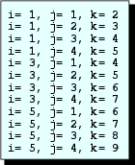
Nested For Loop
int i, j, k, m=0;
for (i=1; i<=5; i+=2)
{
for (j=1; j<=4; j++)
{
k = i+j;
printf ("i=%3d, j=%3d, k=%3d\n", i, j, k);
}
m = k+i;
}
Output

Slide 48
Nested For Loops
At least one loop within a loop
For each value of the outermost counter variable, the complete inner loop will be executed once
In example above,
  outer loop is executed three times, when i = 1, 3, and 5
  for each iteration of i, j-loop is executed four times
  total number of times inner loop executed is 3 * 4 = 12 times
ANSI C requires that a compiler allow at least 15 nesting levels
Indentation commonly is used by programmers to make the code easy to read

Slide 49
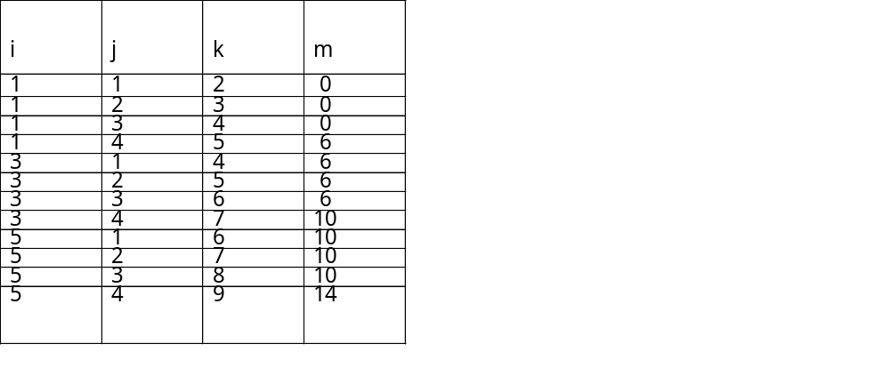
Nested For Loops
Indentation commonly is used by programmers to make the code easy to read
To debug loops that do not work correctly
  Helpful to make a table of the values of each variable calculated in the loop and the loop counters
  Write printf statements within the loops to print the variables and counters on each step
Table of values for variables in nested for

Slide 50
Example：write a program to produce the following output.
******
******
******
******
#include <stdio.h>
void main（）
{
int i,j;
for(i=1;i<=4;i++)
{ for(j=1;j<=6;j++)
printf(“*”);
printf(“\n”);
}
}

Slide 51
Example：write a program to produce the following output.
******
*****
****
***
**
*
#include <stdio.h>
void main（）
{
int i,j;
for(i=1;i<=6;i++)
{ for(j=1;j<=7-i;j++)
printf(“*”);
printf(“\n”);
}
}

Slide 52
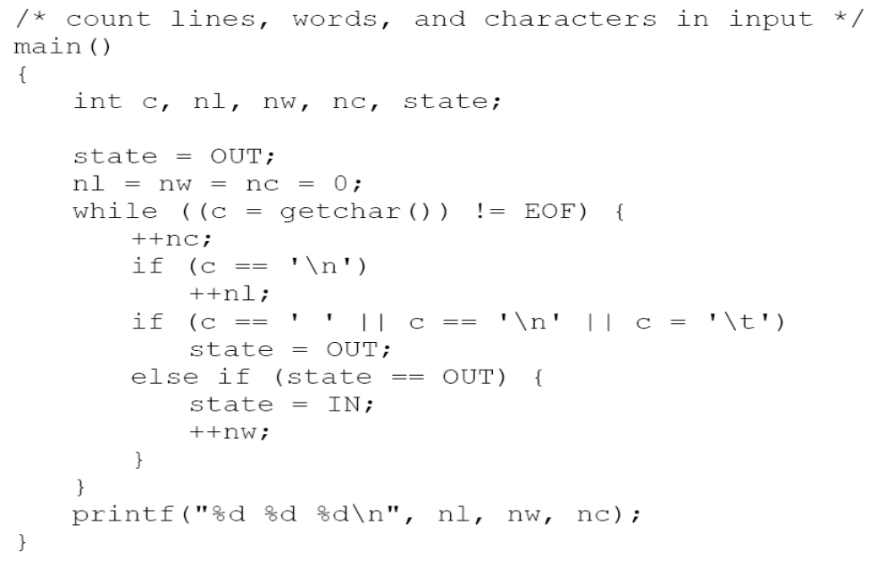


Slide 53
#include <stdio.h>
void main( )
{ int x, y, z, j=0;
for (x=0; x<=100; x++)
for (y=0; y<=100; y++)
for (z=0; z<=100; z++)
if ( x+y+z==100 && 5*x+3*y+z/3==100 )
printf("%2d:cock=%2d hen=%2d chicken=%2d\n",
++j,x,y,z);
}
Output：
  1: cock= 0 hen=25 chicken=75
  2: cock= 3 hen=20 chicken=77
  3: cock= 4 hen=18 chicken=78
  4: cock= 7 hen=13 chicken=80
  5: cock= 8 hen=11 chicken=81
  6: cock=11 hen= 6 chicken=83
  7: cock=12 hen= 4 chicken=84
x
第 <number> 页

Slide 54
#include <stdio.h>
  void main( )
  { int x, y, z, j=0;
  for (x=0; x<=20; x++)
  for (y=0; y<=33; y++)
  for (z=0; z<=100; z++)
  if ( z%3==0 && x+y+z==100 &&5*x+3*y+z/3==100 )
  printf("%2d:cock=%2d hen=%2d chicken=%2d\n",
    ++j, x, y, z ) ;
  }
Output：
  1: cock= 0 hen=25 chicken=75
  2: cock= 4 hen=18 chicken=78
  3: cock= 8 hen=11 chicken=81
  4: cock=12 hen= 4 chicken=84
第 <number> 页

Slide 55
for (x=0; x<=20; x++)
  for (z=0; z<100; z+=3)
  { y = 100-x-z;
  if ( 5*x+3*y+z/3==100)
  printf("%2d:cock=%2d hen=%2d chicken=%2d\n",
  ++j, x, y, z ) ;
  }
for (x=0; x<=20; x++)
  for (y=0; y<=(100-5*x)/3; y++)
  { z = 100-x-y;
  if ( z%3==0 && 5*x+3*y+z/3==100)
  printf("%2d:cock=%2d hen=%2d chicken=%2d\n",
  ++j, x, y, z ) ;
  }
第 <number> 页

Slide 56
void copyij(int src[2048][2048],
int dst[2048][2048])
{
int i,j;
for (i = 0; i < 2048; i++)
for (j = 0; j < 2048; j++)
dst[i][j] = src[i][j];
}
void copyji(int src[2048][2048],
int dst[2048][2048])
{
int i,j;
for (j = 0; j < 2048; j++)
for (i = 0; i < 2048; i++)
dst[i][j] = src[i][j];
}
59,393,288 clock cycles
1,277,877,876 clock cycles
(Measured on 2GHz
Intel Pentium 4)
21.5 times slower!
  Hierarchical memory organization
  Performance depends on access patterns
    Including how step through multi-dimensional array
Notes:
10‘

Slide 57
Thank you!
Q & A

